Slide 1
Panel 9: IPR governance systems Transnational Intellectual Property Governance on the Internet
ATRIP 39th Annual Congress
Prof. Dr. Alexander Peukert
Goethe University Frankfurt am Main
a.peukert@jur.uni-frankfurt.de
Notes:
Forthcoming with Routledge in 2022: The Law of Global Digitality; co-editor, president contributed a paper

Slide 2
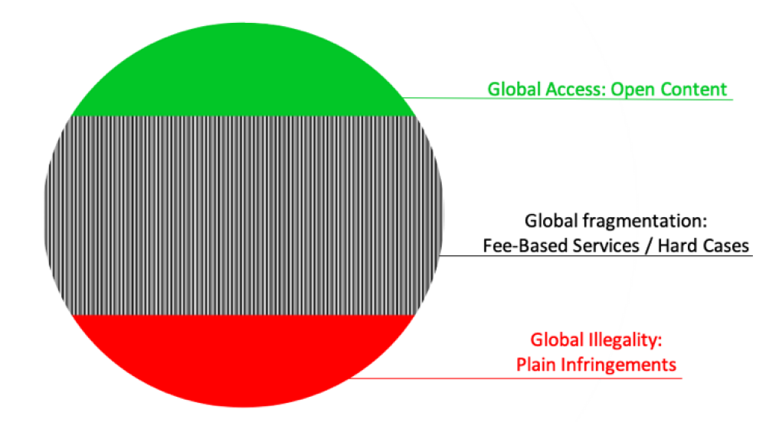
Three layers of global IP governance online:

Slide 3
Global access
Global norm: free accessibility of the content irrespective of the locus of the right holder, the user and any intermediary involved
Concerns Open Content
FOSS
Creative Commons
Open Access in academia

Slide 4
Global fragmentation:
Global norm: access and use rules depend on the locus of the user (→ territoriality)
Concerns
Markets for IP: licensed, fee-based services
Conflicts of IP laws
German Thomas Mann publisher v U.S. Project Gutenberg (Higher Regional Court Frankfurt am Main 2019)
Liability of online platforms
Conflict of IP rights
CJEU Merck Germany v Merck U.S. 2017
Notes:
Do not make available German language works of Thomas Mann in the PD in the US but still protected under German law until the end of 2025 (died in 1955)
concerning the use of the name ‘MERCK’ on the internet in domain names and social media platforms, as well as in business names, both in Germany and elsewhere in the European Union.

Slide 5
Global illegality
Global norm: content should be inaccessible
Concerns manifestly infringing content
Cancellation or transfer of domain names registered by bad faith “cybersquatters” (ICANN’s 1999 UDRP)
© Takedowns and staydowns:
Court orders with de facto global effect
Service-wide IP content moderation by host-providers and search engines
Notes:
the UDRP requires registrants and domain name applicants to submit to mandatory administrative proceedings in the event that a trademark holder asserts that (1) a registered domain name is identical or confusingly similar to a trademark, (2) the domain name holder has no rights or legitimate interests in respect of the domain name, and (3) the domain name has been registered and is being used in bad faith. Through its inclusion in registration agreements of all ICANN-accredited registrars, the UDRP has become a global legal standard, binding upon all holders of generic and numerous country-code TLDs, irrespective of the domicile of the registrant and the other parties involved. The vast majority of many thousand UDRP panel decisions has been in favor of trademark owners and has not given rise to an admissible review by state courts

Slide 6
Global illegality
Concerns manifestly infringing content
Follow the money I:
RogueBlock® payment processor initiative 2012
Cooperation between the International Anti Counterfeiting Coalition and the payment industry “to create a streamlined, simplified procedure for members to report online sellers of counterfeit or pirated goods directly to credit card and financial services companies with a goal of facilitating prompt action against counterfeiters’ merchant accounts and diminishing the ability of such sellers to profit from their illicit sales …”
Notes:
the U.S. government has encouraged and supported an initiative called “RogueBlock®”, which was launched in 2012 and now includes many of the biggest payment providers in the world. more than 250 companies and organizations from 40+ countries. report online sellers of counterfeit or pirated goods directly to credit card and financial service companies with the goal of facilitating prompt action against those merchants. According to the IACC, the program has terminated over 5,000 merchant accounts and impacted over 200,000 websites Website of IACC <https://www.iacc.org/> accessed 23 September 2020.

Slide 7
Global illegality
Concerns manifestly infringing content
Follow the money II:
WIPO ALERT 2019:
“Advertisers, advertising agencies and their technical service providers can apply to become authorized users of WIPO ALERT in order to access aggregated lists of infringing websites from around the world. They can use this information in their automated advertising systems to avoid placing advertisements on such sites. In this way, they can avoid subsidizing copyright infringement and protect their brands from the negative reputational effect of association with illegal activities.”
Extension to the blocking of structurally infringing websites by access providers?

Slide 8
Legitimacy of the three norms
Access: party autonomy
Fragmentation: territoriality of IPRs/laws
Illegality: rough consensus that at least “wilful trademark counterfeiting” and “copyright piracy on a commercial scale” (Art. 61 TRIPS) ought to be suppressed

